Slide 1
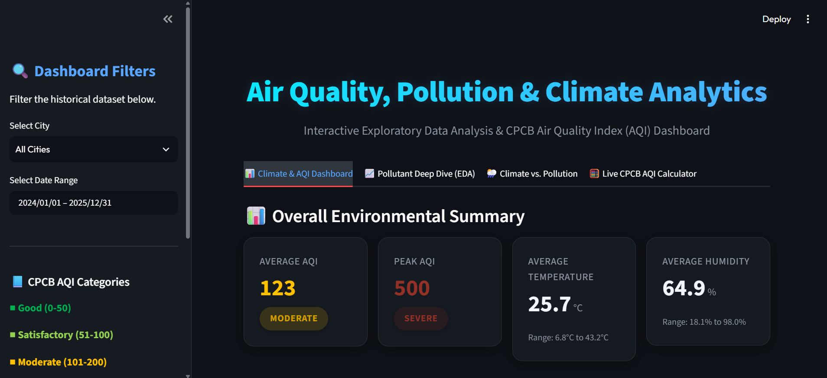
AirWatch
India
Air Quality, Pollution & Climate Analytics
Interactive Exploratory Data Analysis & CPCB Air Quality Index (AQI) Dashboard
covering historical data (2024–2026)
Presented by: Nasim Anwar (12400578)
Lovely Professional University
Diploma in Computer Science & Engineering

Slide 2
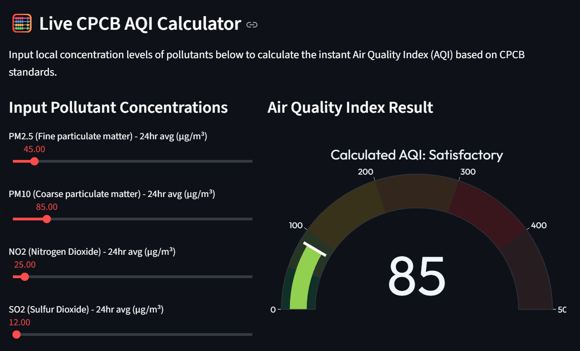
Problem
Statement
Why Air Quality Analysis?
1
Air pollution is a growing public health and environmental concern across Indian cities, driven by vehicular emissions, industrial activity and shifting seasonal weather.
2
Pollutant readings — PM2.5, PM10, NO2, SO2, CO, O3 — are publicly tracked by CPCB, but raw numbers are hard to interpret without proper tools for trend analysis, comparison and visualization.
3
Most citizens have no simple way to check what today's pollutant levels actually mean for local air quality.
AirWatch India • Nasim Anwar (12400578)
2

Slide 3
Project
Overview
What is AirWatch India?
AirWatch India is an interactive web-based dashboard built with Python, Streamlit and Plotly to evaluate air quality, pollution and climate patterns across four major Indian metro cities from 2024 to 2026.
The dashboard converts raw pollutant and weather readings into meaningful visual insights — AQI trends, pollutant distributions, weather correlations and category breakdowns — using interactive filters and a live CPCB AQI calculator.
AirWatch India • Nasim Anwar (12400578)
3

Slide 4
Objectives
1
2
3
4
Track how AQI and key pollutants trend over time across Indian cities.
Identify the most polluted cities and pinpoint pollutant hotspots.
Study how weather — wind speed, humidity, temperature — influences AQI.
Provide a live, interactive CPCB-standard AQI calculator for anyone to use.
AirWatch India • Nasim Anwar (12400578)
4

Slide 5
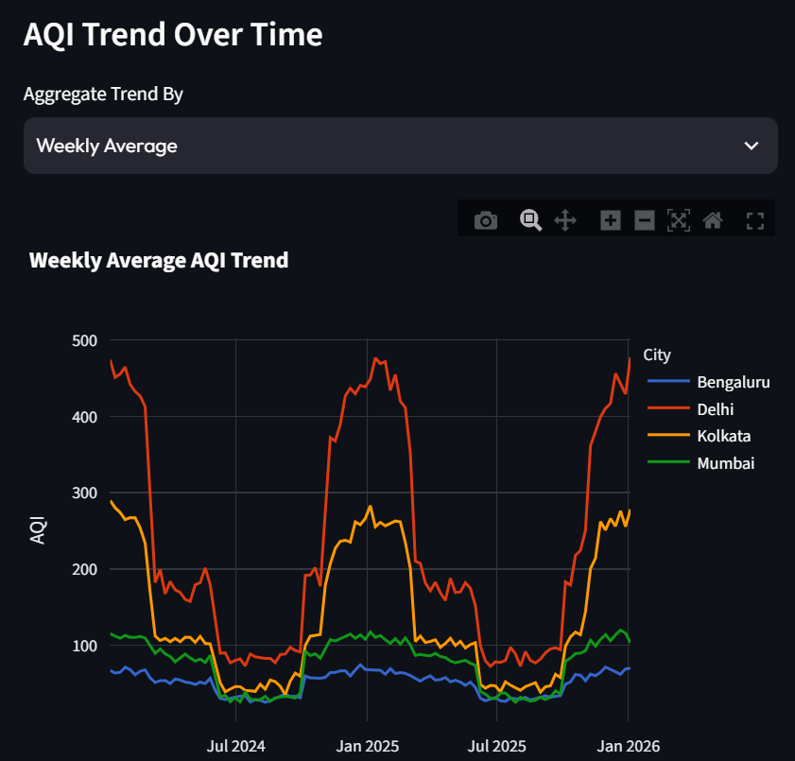
Dataset
Overview
Source
Features Used
Historical Air Quality & Climate dataset covering 4 major Indian metro cities (2024 – 2026), styled on CPCB monitoring parameters.
• Date
• City
• PM2.5
• PM10
• NO2
• SO2
• CO
• O3
• Temperature
• Humidity
• WindSpeed
• Rainfall
• AQI
• AQI Category
Dataset Size
2,924 daily records
4 major metro cities
Jan 2024 – Dec 2026 date range
Delhi
Mumbai
Bengaluru
Kolkata
AirWatch India • Nasim Anwar (12400578)
5

Slide 6
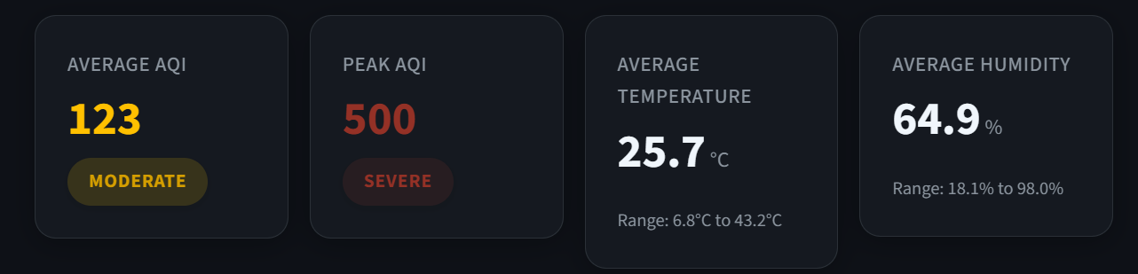
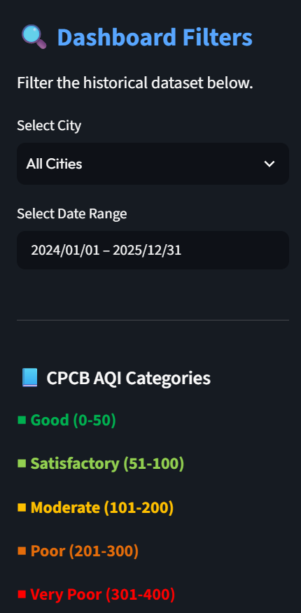
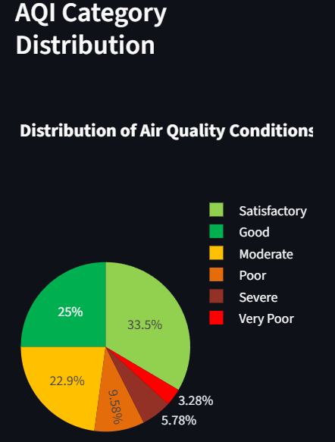
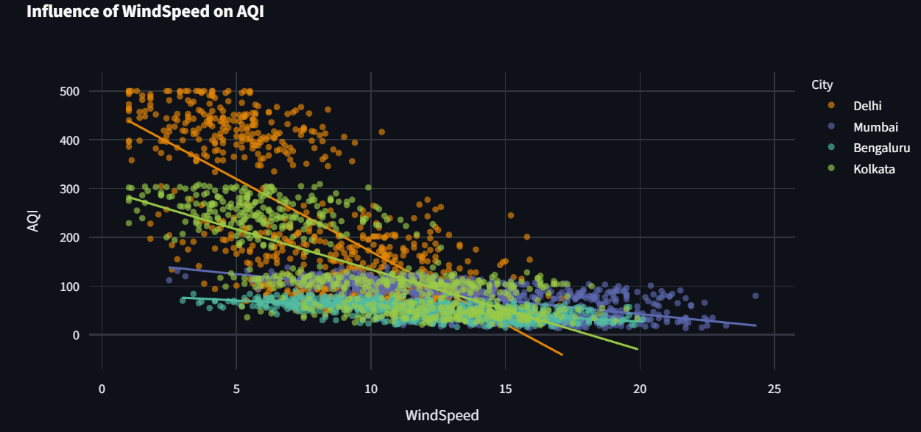
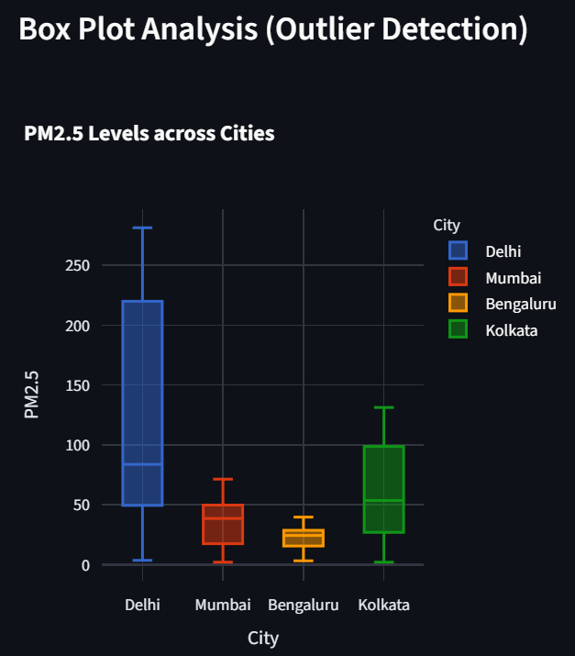
Dashboard Features
Filters
Key Performance Indicators (KPIs) & Visualizations
Pollutant EDA, correlations and a live CPCB AQI calculator round out the toolkit.
AirWatch India • Nasim Anwar (12400578)
6

Slide 7
Conclusion
1
Successfully transformed raw pollutant and weather data into meaningful, actionable insights.
2
The dashboard reveals clear seasonal and city-wise pollution patterns across India.
3
Interactive visualizations and a live AQI calculator make air quality exploration simple for anyone.
Thank You
Built with Python, Streamlit & Plotly
Nasim Anwar (12400578)
Lovely Professional University
Diploma in Computer Science & Engineering

